Slide 1
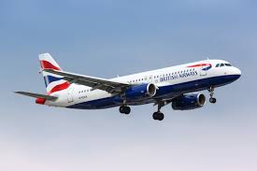

BRITISH AIRWAYS CUSTOMER REVIEWS ANALYSIS
VETAPALEM PRAVALLIKA

Slide 2
INTRODUCTION:
To analyse the customer experience of travelling with British Airways, we focus on evaluating the comfort and convenience provided by the airline.
This involve assessing aspects such as the seating arrangement, in-flight ambiance, and the quality of service offered by the crew.
By examining customer reviews and ratings, we can identify the airline’s strengths and pinpoint areas needing improvement like comfort and seating, in-flight experience, service quality, areas for improvement.

Slide 3
OBJECTIVES:
Collection of customer reviews from multiple platforms like for example Trustpilot, Google Reviews and social media.
Categorization of reviews into various aspects such as customer service, in-flight experience, punctuality and value for money.
To provide actionable insights for British Airways to enhance customer experience.
To identify common customer pain points and areas of excellence.

Slide 4
Data scraping of some services:
Comfort seating
In-flight experience
Service quality
Call service

Slide 5
Data Scraping:
Comfort& Seating
Rating 3.5
Service quality
Rating 5.0
In-flight Experience
Rating 4.0
Call service
Rating 4.5

Slide 6
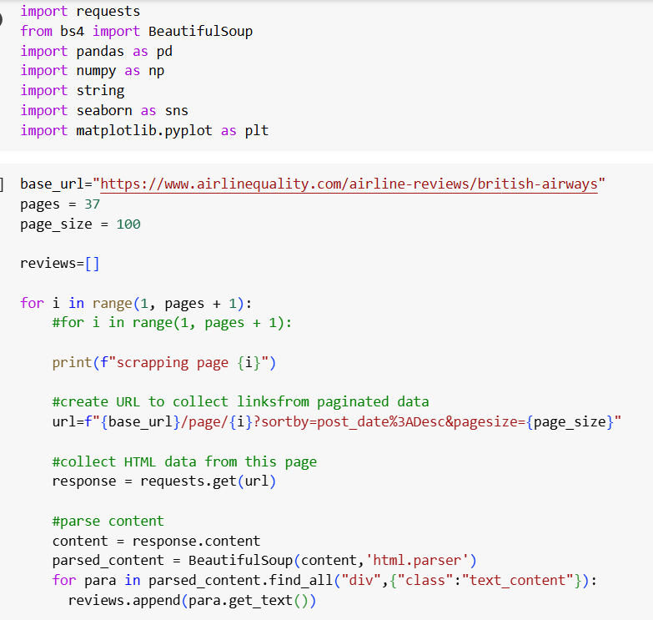
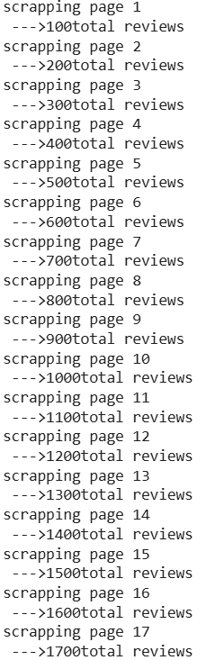

Data scraping through python

Slide 7

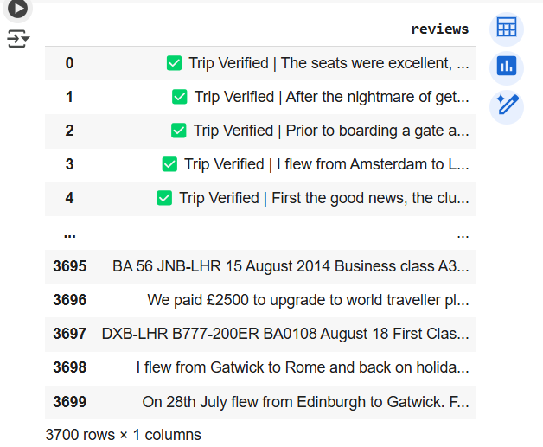

Slide 8
Areas to work by analysing customer reviews
Communication and navigation information to the customers have to be highly increased as customers are facing a lot of problems by services given by airlines mainly in connecting flights.
Complaint about old business class seatings.
Economy class facilities must be increased as very low ratings is given over all services like legroom, comfort, staff service, food and beverages, inflight entertainment, etc.
For business class ground service rating low.

Slide 9
AREAS OF IMPROVEMENT
Identifying recurring themes in negative reviews, such as discomfort in economy class, delays, or poor customer service.
Providing targeted recommendations to address those issues, such as upgrading seats, enhancing crew training or improving in-light amenities.
Improve scheduling and communication (real-time updates, better rebooking assistance).
Optimize baggage handling(Real time tracking,stricter quality,faster resolutions)
Improve scheduling and communication (real-time updates, better rebooking assistance).

Slide 10
CONCLUSION:
By acting on these insights, British Airways can enhance the travel experience for passengers, leading to increased customer satisfaction and loyalty. This, in turn, can result in higher profitability and a stronger competitive position in the airline industry.
By continuously improving and adapting based on customer feedback, British Airways can attract more passengers, increase market share, and maintain its reputation as a preferred airline for travellers seeking comfort and excellent service

